Slide 1
THE LAND OF SONG

Slide 2
LAND OF SONG
Wales is known as the ‘land of song’ as singing is a significant part of Welsh national identity.
In the Urdd, there are many competitions for singing such as solos, duets and choirs.
Wales has produced some of the finest singers in the world. Let’s take a look at some of them.

Slide 3
CHOIRS
There are many choir types in Wales but the most famous is the male voice choir. All-male choirs are part of a centuries-old musical tradition in Wales. They emerged in the 19th century out of chapel singing and from the country’s mines, shipyards, factories and docks.
One of the most famous and successfully competitive male voice choirs in Wales is Pontarddulais Male Voice Choir.
http://www.pontarddulaismalechoir.com/
https://www.youtube.com/channel/UCQqnrLicmKpShH3bpwZGfJg

Slide 4
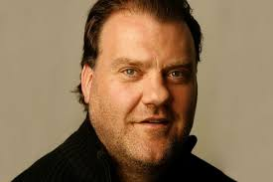
CLASSICAL SINGERS
Sir Bryn Terfel (born 9/11/65) is a Welsh bass-baritone opera and concert singer. In 1990 he made his operatic debut at the Welsh National Opera and has continued to star in famous operas to this day. He has collaborated with many other famous opera stars and pop stars.

Slide 5
CLASSICAL SINGERS
Katherine Jenkins (born 29/6/80) is a Welsh operatic pop singer. She is a mezzo-soprano and performs operatic arias, popular songs, musical theatre and hymns. She has been seen widely in concert and has performed for the British Armed Forces. She has sung at sporting events, on television shows, and in support of many charities.

Slide 6
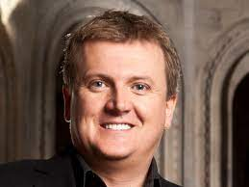
CLASSICAL SINGERS
Aled Jones (born 29/12/70) is a Welsh singer and radio and TV presenter. As a teenage chorister, he reached widespread fame during the mid-1980’s. Since then he continues his singing career while balancing radio presenting on Classic.fm and TV presenting with the BBC and ITV.

Slide 7
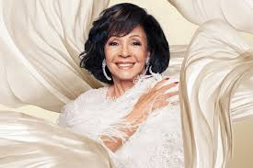
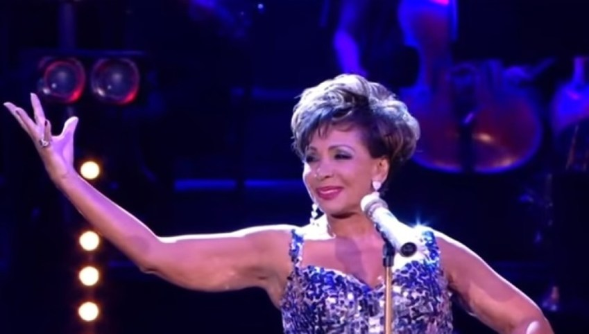
POP SINGERS
Dame Shirley Bassey (born 8/1/37) is a Welsh singer from Tiger Bay, Cardiff. She began performing as a teenager in 1953. In 1959 she became the first Welsh person to gain a number-one single in the UK charts. She became well-known for recording the soundtrack theme to the James Bond films Goldfinger and Diamonds are Forever.

Slide 8
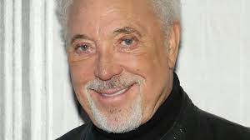
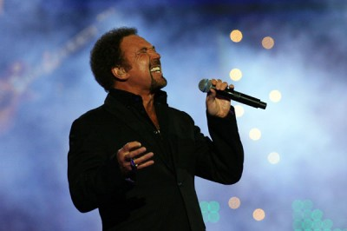
POP SINGERS
Sir Tom Jones (born 7/6/40) is a Welsh singer. He began his career with a string of top-ten hits in the mid-60’s. He has performed across many genres such as pop, R&B, soul and gospel. Some of his most famous hits include ‘Thunderball’, ‘Green, Green Grass of Home’ and ‘Delilah’. He currently is a judge on The Voice.

Slide 9
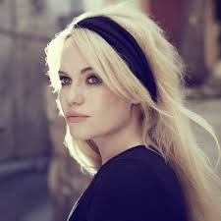
POP SINGERS
Duffy (born 23/6/84) is a Welsh singer, songwriter and actress. Her debut album Rockferry, released in 2008, became the best-selling album in the UK. In 2009, Duffy won the Grammy award for Best Pop Vocal Album and three Brit Awards.

Slide 10
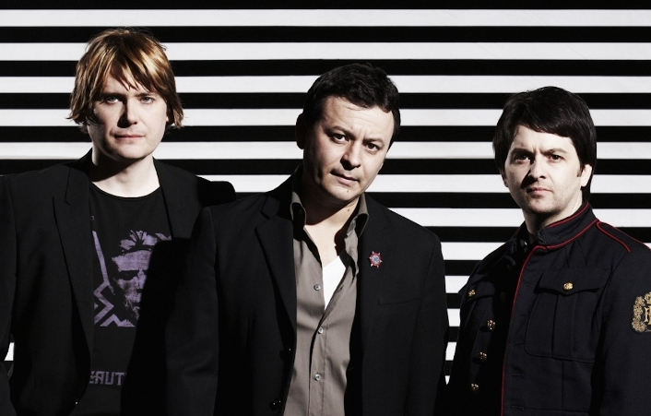
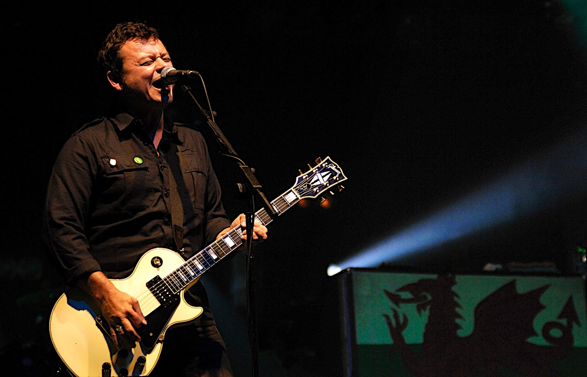
WELSH BANDS
Manic Street Preachers, also known as the Manics are a Welsh rock band formed in Blackwood in 1986. The form a key part of the 90’s Welsh ‘Cool Cymru’ cultural movement. The band achieved commercial success with their album ‘Everything Must Go’. They have sold more than 10 million albums worldwide.

Slide 11
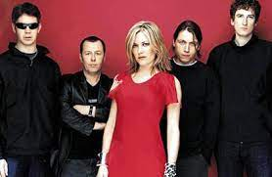
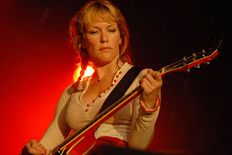
POP SINGERS
Catatonia were an alternative rock band from Wales who gained popularity in the mid-to-late 90’s and formed part of the ‘Cool Cymru’ movement. Their breakout success came in 1998 with their song ‘Mulder and Scully’ which reached number 3 in the singles chart. Their lead singer Cerys Matthews went on to have a successful solo career.

Slide 12
POP SINGERS
Stereophonics are a Welsh rock band from Cwmaman formed in 1992. They have released 11 studio albums, including 7 number one albums. They have achieved a total of ten top-ten singles as well as number one: Dakota. Having sold around 10 million copies worldwide, Stereophonics are one of the most successful Welsh bands.

Slide 13
WHO’S WHO QUIZ
Now that you’ve met a range of famous Welsh singers, can you remember their names or what style they are famous for?
Working in teams, complete the quiz. Once you have answered all the questions, hand your answer sheet over to another team for marking.

Slide 14
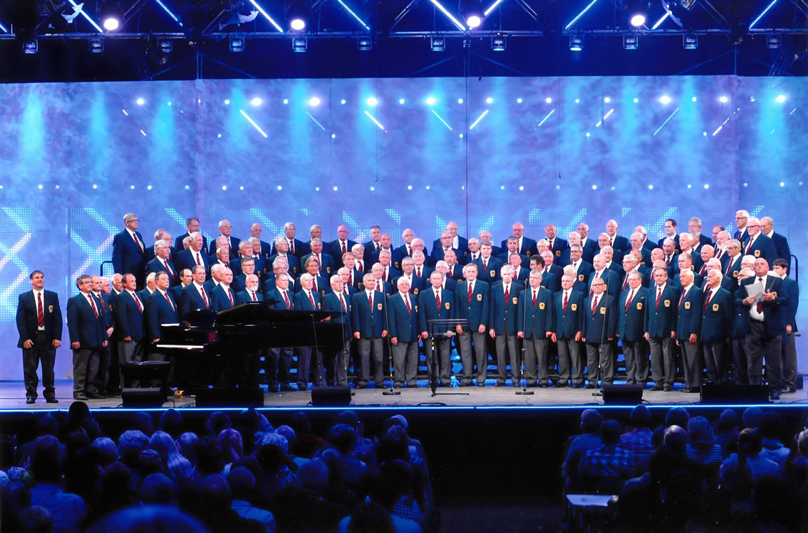
QUESTION 1: WHAT TYPE OF VOCAL ENSEMBLE IS THIS?
A
Male Voice Choir
B
Rock Band
C
Pop Singers

Slide 15
QUESTION 2: WHO IS THIS FEMALE SINGER?
A
Cerys Matthews
B
Duffy
C
Katherine Jenkins

Slide 16
QUESTION 3: WHO IS THIS MALE SINGER?
A
Aled Jones
B
Tom Jones
C
Kelly Jones

Slide 17
QUESTION 4: WHAT IS THE NAME OF THIS BAND?
A
Badfinger
B
Catatonia
C
Manic Street Preachers

Slide 18
QUESTION 5: WHO IS THIS FEMALE SINGER?
A
Duffy
B
Shirley Bassey
C
Marina

Slide 19
QUESTION 6: NAME THE FAMOUS WELSH BAND
A
Catfish and the Bottlemen
B
Stereophonics
C
Manic Street Preachers

Slide 20
QUESTION 7: WHO IS THIS MALE SINGER?
A
Bryn Terfel
B
Harry Secombe
C
Aled Jones

Slide 21
QUESTION 8: NAME THIS WELSH BAND
A
Manic Street Preachers
B
Stereophonics
C
Super Furry Animals

Slide 22
QUESTION 9: WHO IS THIS MALE SINGER?
A
Bryn Terfel
B
Shakin’ Stevens
C
Aled Jones

Slide 23
QUESTION 10: WHO IS THIS FEMALE SINGER?
A
Shirley Bassey
B
Bonnie Tyler
C
Katherine Jenkins

Slide 24
WHO’S WHO ANSWERS
Check you have answered each one and pass your quiz sheets to another team to mark
Let’s see how many you remembered!

Slide 25
QUESTION 1: WHAT TYPE OF VOCAL ENSEMBLE IS THIS?
A
Male Voice Choir
B
Rock Band
C
Pop Singers

Slide 26
QUESTION 2: WHO IS THIS FEMALE SINGER?
A
Cerys Matthews
B
Duffy
C
Katherine Jenkins

Slide 27
QUESTION 3: WHO IS THIS MALE SINGER?
A
Aled Jones
B
Tom Jones
C
Kelly Jones

Slide 28
QUESTION 4: WHAT IS THE NAME OF THIS BAND?
A
Badfinger
B
Catatonia
C
Manic Street Preachers

Slide 29
QUESTION 5: WHO IS THIS FEMALE SINGER?
A
Duffy
B
Shirley Bassey
C
Marina

Slide 30
QUESTION 6: NAME THE FAMOUS WELSH BAND
A
Catfish and the Bottlemen
B
Stereophonics
C
Manic Street Preachers

Slide 31
QUESTION 7: WHO IS THIS MALE SINGER?
A
Bryn Terfel
B
Harry Secombe
C
Aled Jones

Slide 32
QUESTION 8: NAME THIS WELSH BAND
A
Manic Street Preachers
B
Stereophonics
C
Super Furry Animals

Slide 33
QUESTION 9: WHO IS THIS MALE SINGER?
A
Bryn Terfel
B
Shakin’ Stevens
C
Aled Jones

Slide 34
QUESTION 10: WHO IS THIS FEMALE SINGER?
A
Shirley Bassey
B
Bonnie Tyler
C
Katherine Jenkins

Slide 35
End of Quiz
How many did you get right?
Don’t worry if you couldn’t remember all of the names of the Welsh singers and bands!

